Slide 1
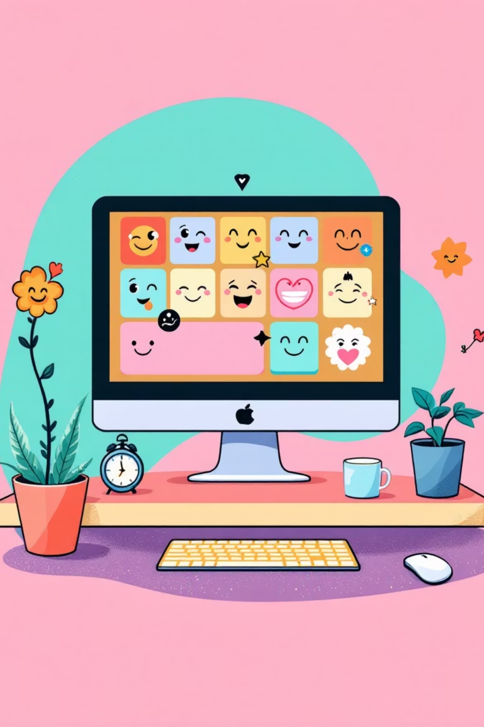
Project 2 – UI/UX Design
Mood Poll Website + Quizzify Mini Quiz Game Presentation By – Sanskruti Jagdale

Slide 2
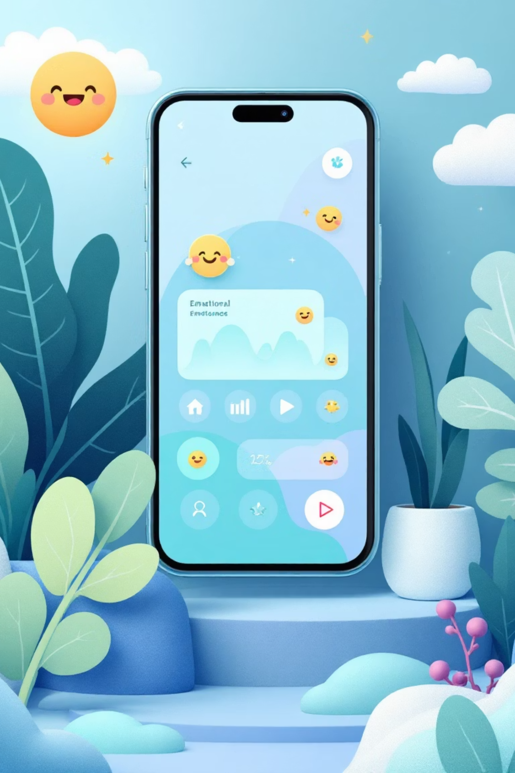
Project Overview
Mood Poll Website
Quizzify Mini Game
An interactive platform that captures users' emotional states through an intuitive emoji-based interface. Features personalized follow-up questions and real-time mood tracking with visual analytics.
A sleek, engaging quiz experience designed with modern UI principles. Clean navigation, instant feedback, and a rewarding user journey that keeps players coming back.

Slide 3
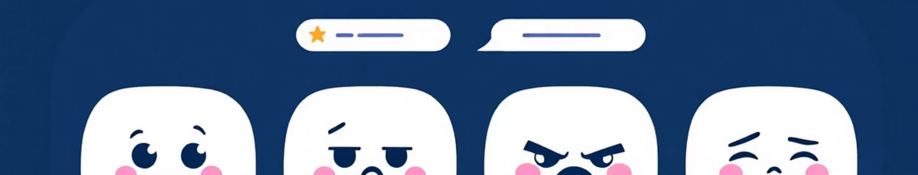
Daily Report – 15th November
Sanskruti
Vaibhav
Mihir
Established the complete visual identity for the Mood Poll, including color palette selection, layout structure, and percentage display formatting for mood analytics.
Designed the core Mood Poll interface featuring four distinct emoji options: Happy, Sad, Angry, and Tired, ensuring optimal spacing and touch targets.
Developed personalized follow-up question flows for each mood state, creating a more empathetic and engaging user experience.

Slide 4
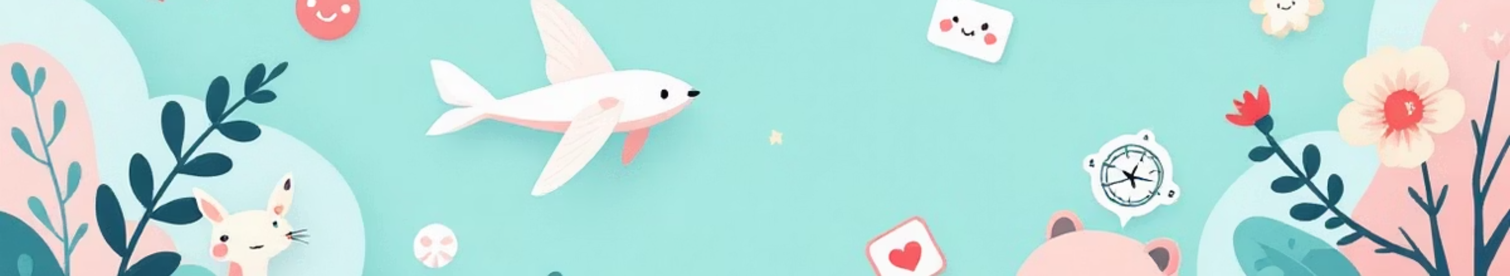


Daily Report – 16th November
Significant progress on visual assets and strategic planning for the next phase of development.
Asset Delivery
Timeline Set
Sanskruti finalized and submitted background designs and mood sticker assets to Sanjay for implementation review.
Team aligned on starting the Mini Quiz Game UI design work by 18th November, ensuring smooth transition between projects.

Slide 5
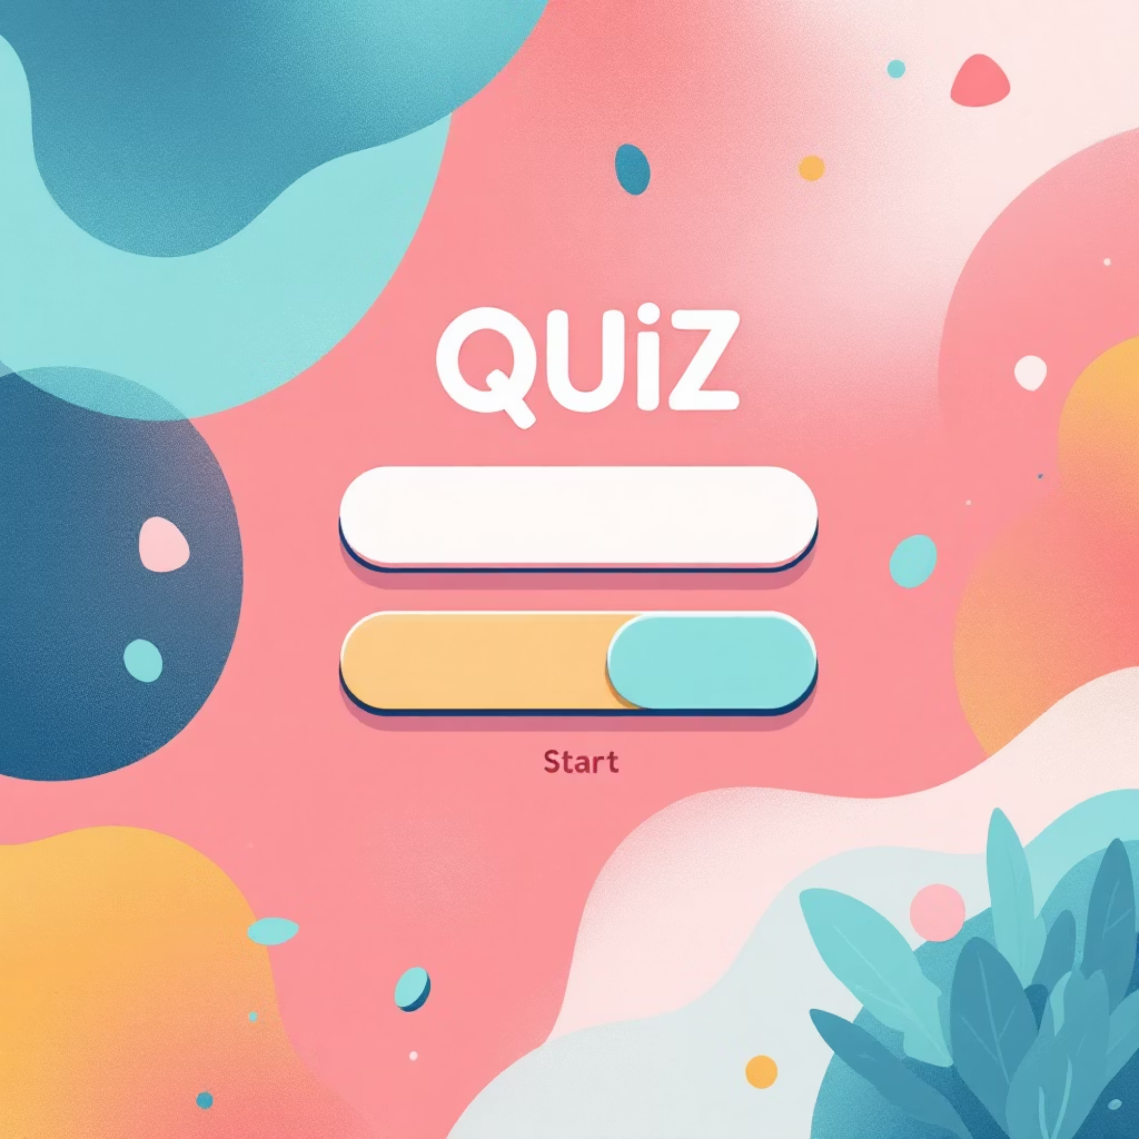
Daily Report – 17th November
Quizzify UI Design Kickoff
The team began designing the complete user interface for Quizzify, our mini quiz game experience.
Focus areas included the start screen, question interface, and results display, all following our established design system.

Slide 6
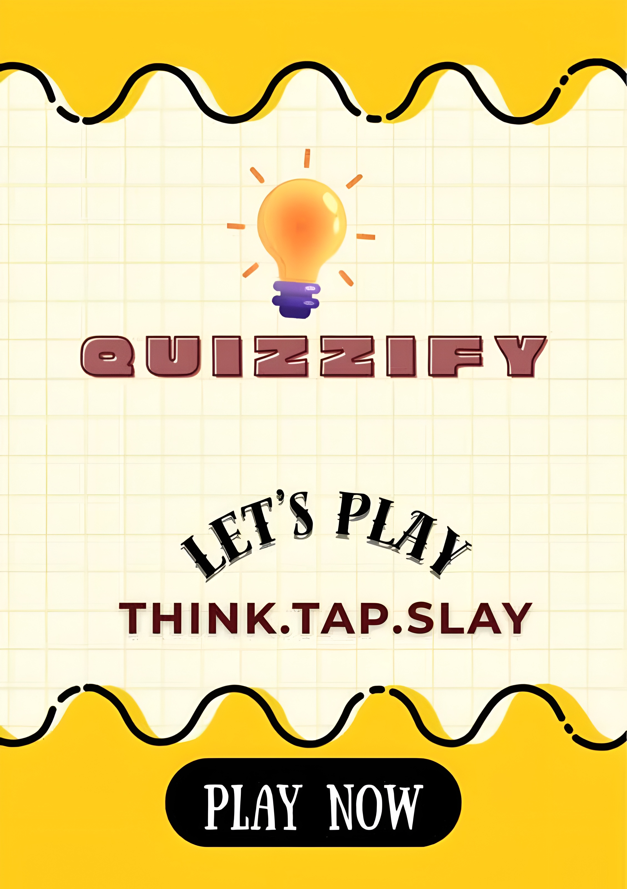
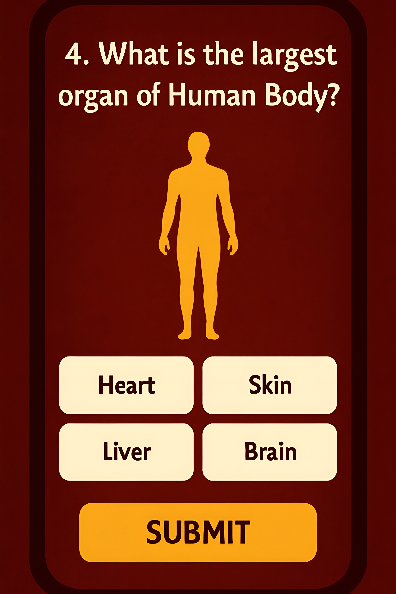
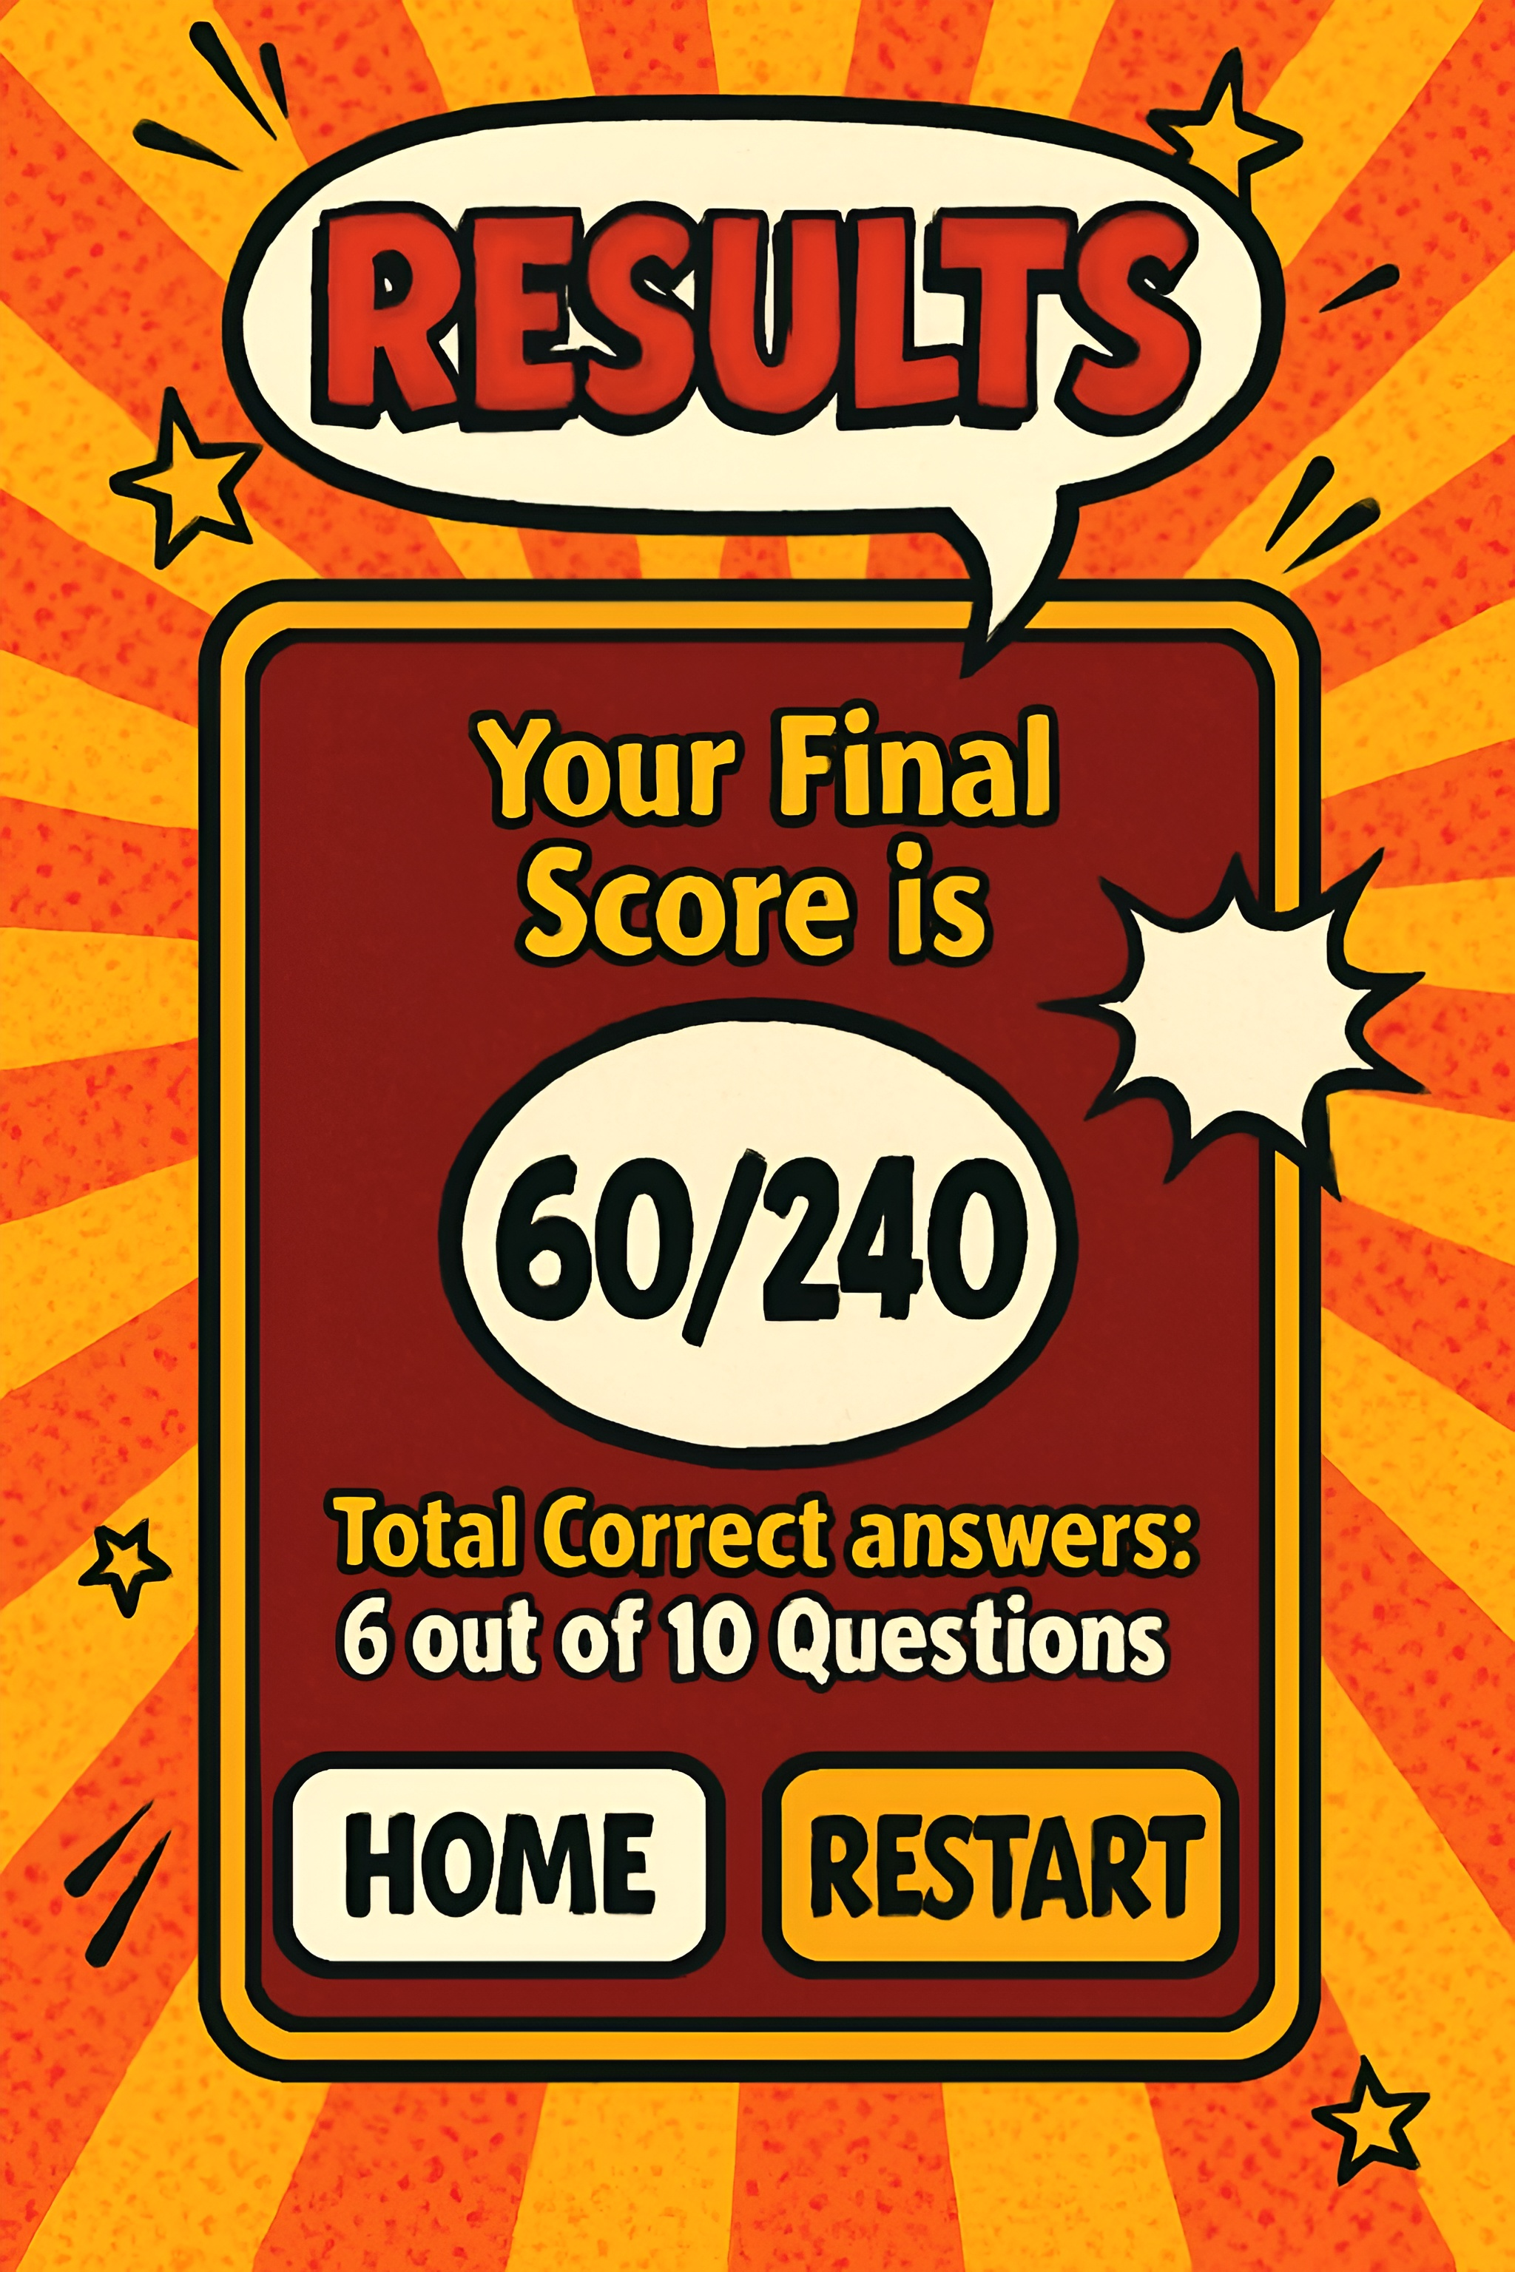
Quizzify Game Screens
The Quizzify experience features three core screens: an inviting start screen, an intuitive question interface with clear answer choices, and a celebratory results display that encourages replay.

Slide 7

Daily Report – 18th November
Project Milestone Achieved
Project 2 reached substantial completion with all major features implemented and only minor refinements remaining.
Final Touches
Sanskruti completed all requested design changes and successfully submitted the finalized assets to the respective team groups for integration.

Slide 8

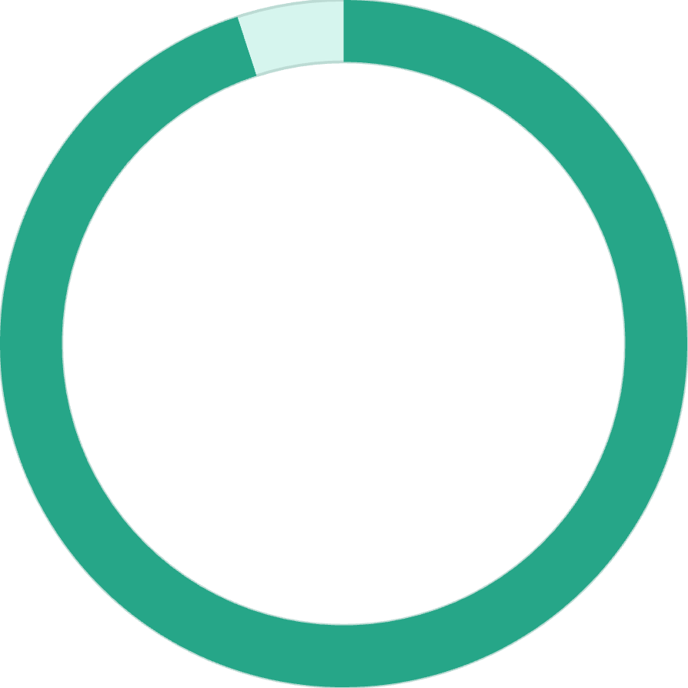
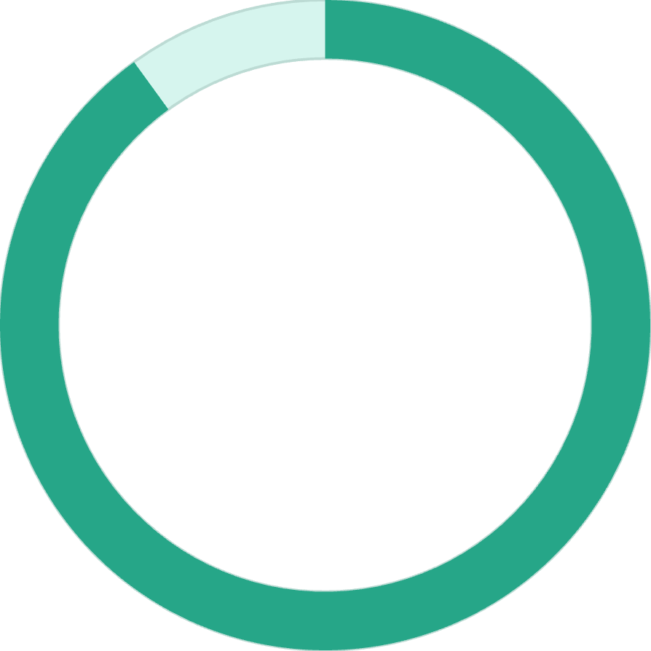
Project Status Summary
100%
100%
100%
Mood Poll UI
Quizzify Game
Overall Progress
Fully completed with emoji interface, follow-up questions, and analytics display
Almost finalized with all core screens designed and minor adjustments pending
Ready for final review and integration phase

Slide 9

Thank You
Project 2 showcases our team's commitment to creating thoughtful, user-centered experiences. Both the Mood Poll and Quizzify represent our dedication to clean design, intuitive interfaces, and meaningful interaction.

